Slide 1
AMERICAN TIME AND LABOR COMPANY ENGAGEMENT
American Time and Labor Company is a fully integrated workforce management platform that allows a business to off-load all of their employer related responsibilities and normalize their total labor cost. The client remains the “primary employer” of record for the businesses employment exposures & liabilities, but they are able to off-load the contingent liability that can occur in Workers Compensation, Tax Management, Time and Labor, and compliance.
Pacific Timecard leverages mobile technology that gives real time feed back on the hours and locations employees are working. Employees sign off on required meal periods and hours worked helping to document these events accurately, which helps protect the employer.
American Time and Labor Company can help a business liberate themselves from all the unintended consequences of being an employer.

Slide 2
As your business grows, so does the challenge of managing all the administration responsibilities that comes with it. Working with American Time and Labor Company, those administration responsibilities become significantly reduced.
Our service offering is a full-service bundle of products and tools called LABORsuite. With LABORsuite your company will get administration relief with access to our suite of products that help manage and streamline your business. These products and services will help reduce the burden of administration responsibilities demanded on American employers by Federal and State Wage-Hour Laws and enable your company the freedom to grow.
Working with American Time and Labor Company and taking advantage of LABORsuite, your company will benefit by having a more efficient workflow, better visibility of your employees and experience reduced costs, while seeing real savings.

Slide 3
THE NEED
Employers need great employees to project a consistent service with exceptional customer service for profitable engagements. Employee’s create enormous responsibility and liability for any employer in the transitional industries or off-site work locations.
THE PROBLEM
Contingent Liability of what these employers are missing. Paid Time Off laws, Increase in Minimum Wage, ACA, (Penalties)
High Labor related cost such as Workers Compensation, payroll cost, Scheduling, etc.
Tools needed to comply with all the measuring requirements, insurance offerings, and reporting.
High Labor related cost such as Workers Compensation, payroll cost, Scheduling, etc.
THE SOLUTION
LABORsuite allows an Employer to off-load all the un-intended consequence of employer related responsibilities and allows a business owner to get back to what they do best… run their business.

Slide 4
A provider of integrated human capital management (HCM) solutions for payroll, human resource (HR), and insurance services for small- to Enterprise-sized businesses in America.
The Company offers services, including Payroll processing, Human Resource Services, Accounting, Time and Attendance and GPS Time Tracking Solutions. It offers a portfolio of services and products that allows its customers to meet their payroll and HR needs.
The Company, through its HCM software-as-a-service platform, provides an integrated product suite to manage Employees, while efficiently enabling Employers to run Companies productively and in line with Federal and State Wage-Hour Laws.
^{n Payroll}
^{n Workers’ Compensation} ^{n Benefits}
n Mobile Time & Attendance - GPS Tracking
^{n Tax Management} ^{n Time-Keeping}
AmericanTimeandLaborCompany.com

Slide 12
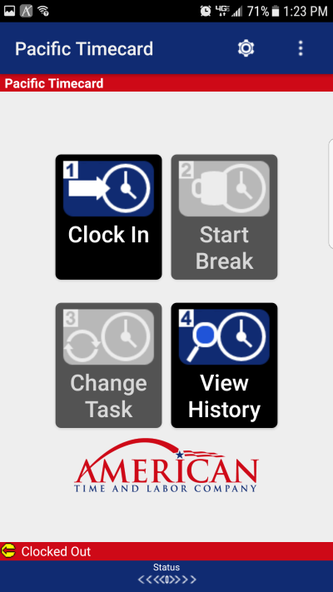
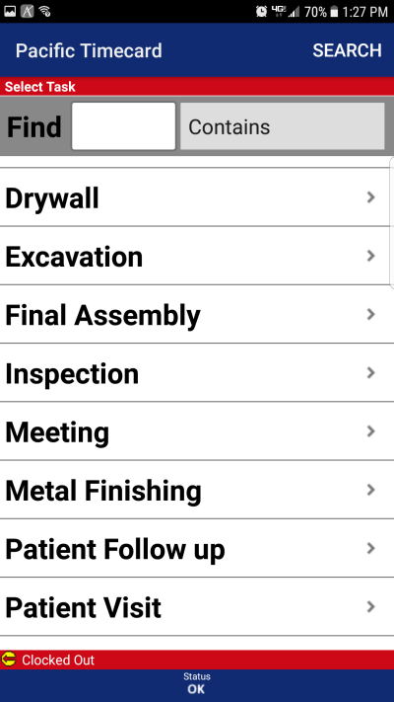
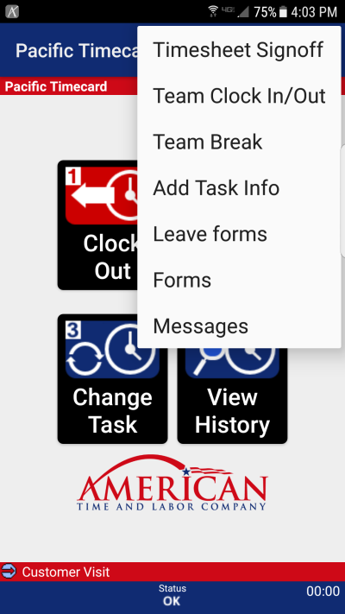
HOME SCREEN
JOBS
DROP DOWN

Slide 13
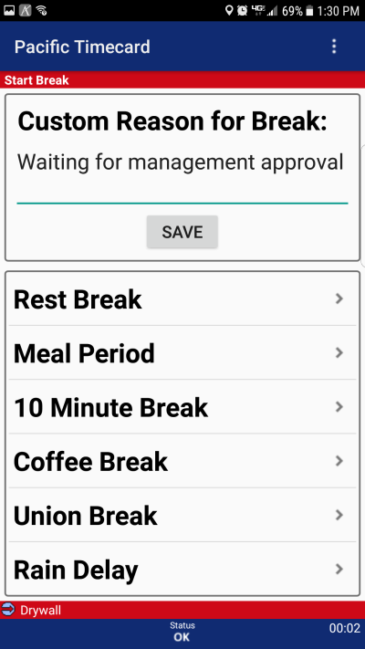
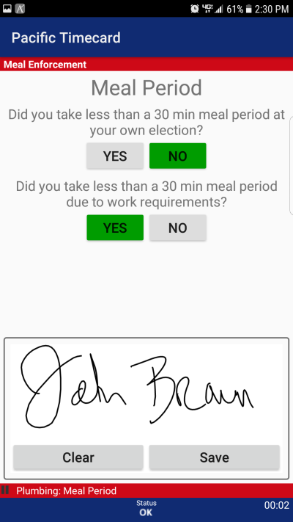
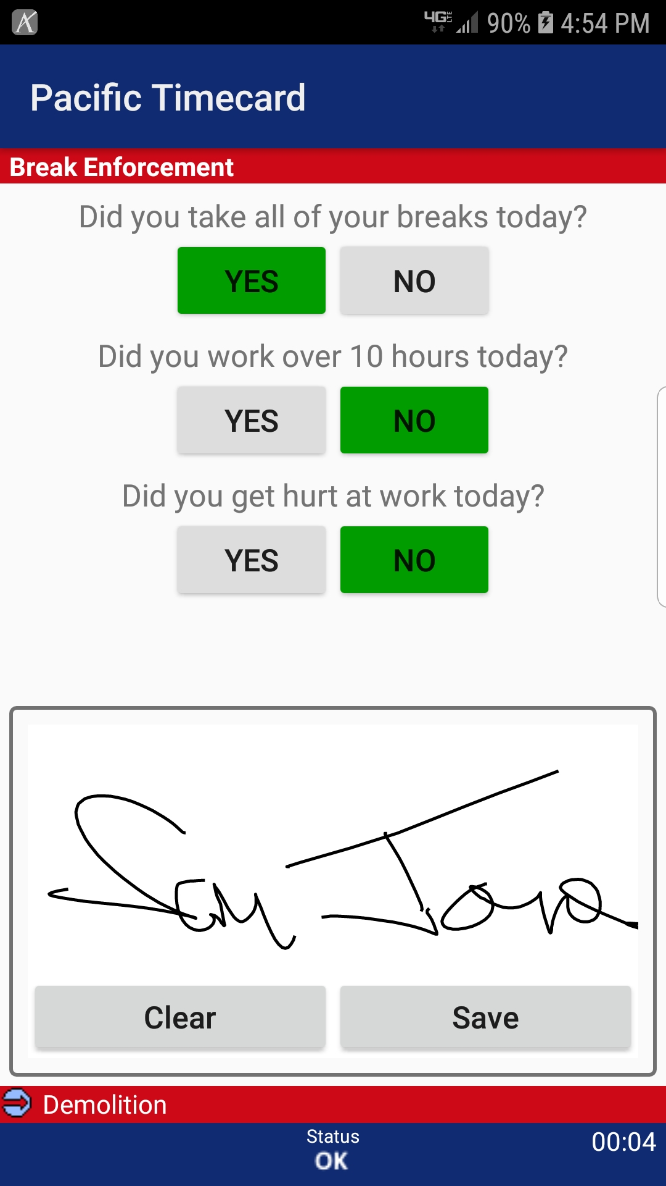
BREAKS
MEAL ENFORCEMENT
QUESTIONS

Slide 15
WE TRULY ARE REDEFINING THE INDUSTRY AND WE HOPE YOU TAKE ADVANTAGE OF OUR SERVICES.
Next steps will be to submit your “demo request” located on our website. We will then send you an
invite to our 10 minute overview presentation of our products and services.
If you would like to receive a quote, please fill out our “request a quote” form located on our
website. We will need the classification codes of your employees, so please provide us
your current Workers’ Compensation Declaration Page so we may fulfil this request.
We look forward to partnering with you… J
AmericanTimeandLaborCompany.com

